Slide 1
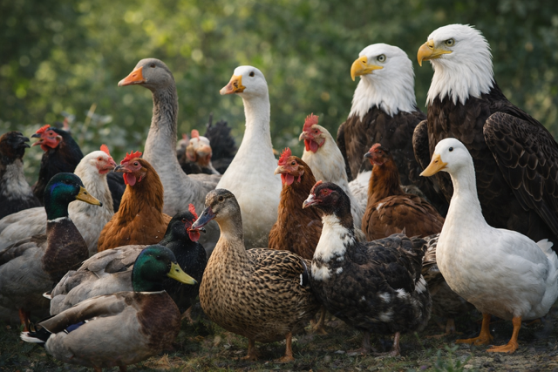
Keeping Your Best People:
A Complete Metaphor-Driven Framework for Keeping Your Best People

Slide 2
Keeping Your Best People
A Complete Metaphor-Driven Framework for Keeping Your Best People
Introduction
Take Care of The Goose That Lays The Golden Eggs
Recognize and Coach the Ugly Duckling
Kick the Fox Out Of The Hen House
Create an Eagle Culture
Conclusion

Slide 3
Introduction
Employers across nearly every industry, especially skilled trades like electricians, are facing a growing set of obstacles when trying to hire new people.
Notes:
Employers across every industry is facing obstacles when hiring new people.

Slide 4
Obstacles
1. Fewer young people are entering the workforce, and even fewer are entering the trades.
2. Retirements are accelerating faster than new hires can replace them.
3. Many experienced workers are aging out with no succession plan in place.
4. Wage & Benefit Pressure
  Candidates expect benefits earlier and at higher levels than in previous generations.
  Employers must balance competitiveness with long-term sustainability.

Slide 5
Obstacles
6. Background, Screening, & Compliance Barriers
  Failed drug tests, driving record issues, or background checks limit hiring options.
  Licensing (Driver’s License), certification, and regulatory requirements slow onboarding.
7. Transportation & Location Challenges
  Job sites may be too far.
  Reliable transportation remains a barrier for entry-level workers.
5. Skills Gap & Lack of Job Readiness
  Younger workers often seek purpose, flexibility, and growth- not just a paycheck.
  Traditional management styles may not resonate with newer generations.
  Lack of mentorship and feedback leads to early turnover.

Slide 6
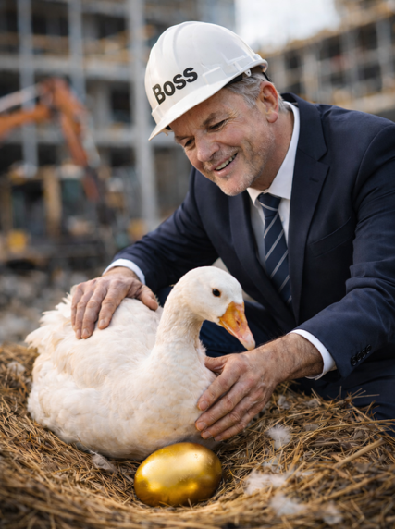
Take Care of the Goose That Lays The Golden Eggs
Notes:
Protect and Invest in your top performers (Who are my top Performers?)
Identify your top performers by tracking reliability, attitude, craftsmanship, and willingness to grow
Give them what they need to get better
Tools
Mentorship
Growth Opportunities
Reward Employees when they get better
Public praise
Bonuses
Pathway to leadership
Remove Barriers to Success
Assist with Scheduling (Employee needs to drop their kids off for school)
Reduce unnecessary administration headaches
Provide Clear Communication
Create a Culture that’s inviting

Slide 7
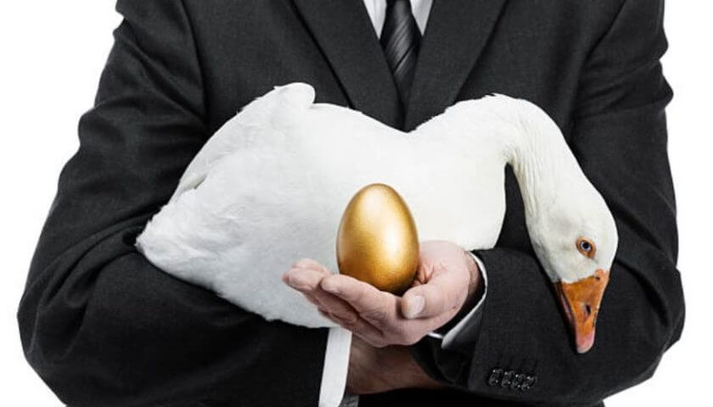
Take Care of the Goose That Lays the Golden Eggs (Protect and Invest in Your Top Performers)
Identify Your High Performers
  Track reliability, attitude, craftsmanship, and willingness to grow.
Give Them What They Need to Thrive
  Tools, training, mentorship, and growth opportunities
Notes:
Protect and Invest in your top performers (Who are my top Performers?)
Identify your top performers by tracking reliability, attitude, craftsmanship, and willingness to grow
Give them what they need to get better
Tools
Mentorship
Growth Opportunities

Slide 8
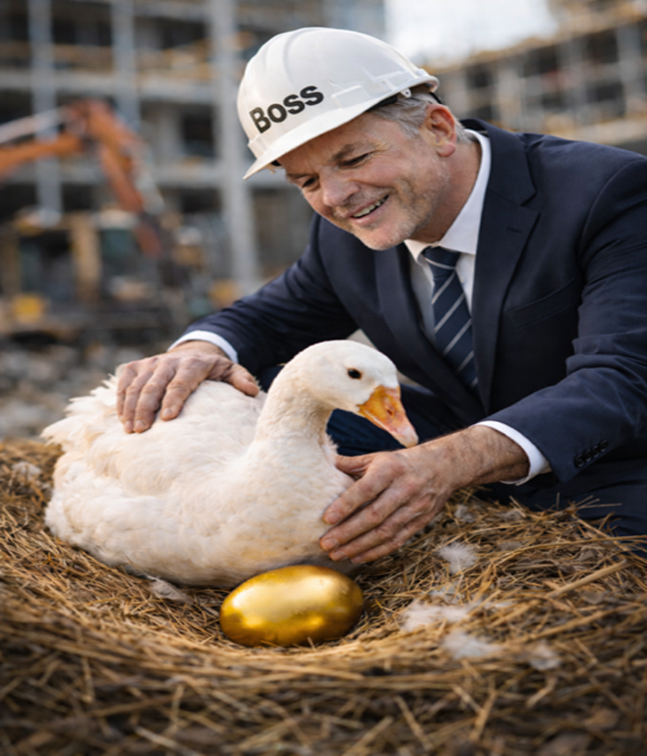
Take Care of the Goose That Lays the Golden Eggs (Protect and Invest in Your Top Performers)
3. Reward & Recognize Consistently
  Public praise, bonuses, leadership pathways, and appreciation culture
4. Remove Barriers to Their Success
  Fix scheduling issues, reduce administrative headaches, and provide clear communication.
5. Create an Environment They Want to Stay In
  Psychological safety, respect, and feeling valued
Notes:
Protect and Invest in your top performers (Who are my top Performers?)
Reward Employees when they get better
Public praise
Bonuses
Pathway to leadership
Remove Barriers to Success
Assist with Scheduling (Employee needs to drop their kids off for school)
Reduce unnecessary administration headaches
Provide Clear Communication
Create a Culture that’s inviting

Slide 9
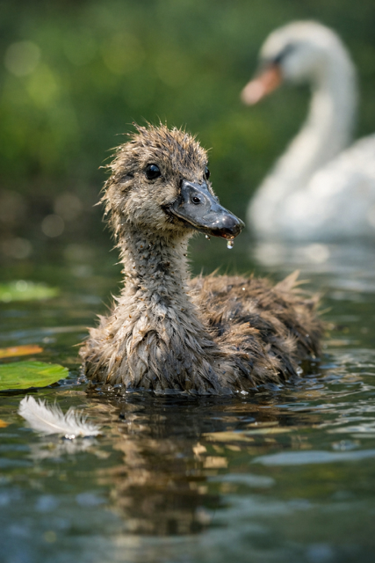
Recognize the
Ugly Duckling
Notes:
(Develop potential instead of discarding it)

Slide 10
Recognize the Ugly Duckling
(Develop Potential Instead of Discarding It)
1. Spot the Hidden Talent
  Identify apprentices or employees who need time, structure, or extra help
2. Provide Coaching Instead of Criticism
  Positive reinforcement, corrective guidance, and clear expectations
3. Implement Growth Plans
  Skill-building programs, mentorship, weekly check-ins, and progress tracking

Slide 11
Recognize the Ugly Duckling
(Develop Potential Instead of Discarding It)
4. Celebrate Improvements
  Small wins build motivation.
5. Reduce Turnover By Lifting People Up
  Most people don’t leave jobs; they leave environments where they feel they can’t grow.

Slide 12
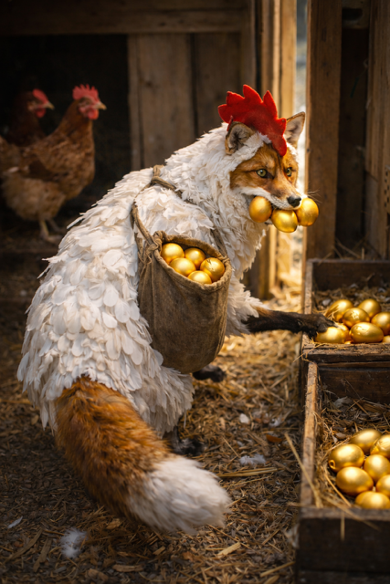
Kick the Fox Out of the Hen House

Slide 13
Kick the Fox Out of the Hen House
(Remove People, Habits, or Systems that Destroy Culture)
1. Identify Toxic Behaviors
  Gossip, negativity, laziness, bad attitudes, or unsafe practices
2. Confront Issues Quickly
  Address disruptions before they spread to your team.
3. Hold People Accountable
  Clear consequences, documented conversations, and alignment with company values
Remove the True Foxes
  Sometimes retention means letting go of the people who hurt morale.
Protect Your Culture
  Reinforce standards, expectations, and professionalism.

Slide 14

Build a Retention-Focused Culture
Notes:
(Create an environment where excellence thrives and people want to stay)

Slide 15
Build a Retention-Focused Culture
(Create an Environment where Excellence Thrives and People Want to Stay)
Eagles Set the Tone
  High standards, professionalism, and pride
Eagles See the Vision
  Clarity, direction, and purpose for the team
Eagles Lift Others
  Mentorship, training, and positive leadership

Slide 16
Build a Retention-Focused Culture
(Create an Environment where Excellence Thrives and People Want to Stay)
Eagles Protect the Culture
  Shutting down toxicity and building unity
Eagles Reward Excellence
  Reinforce loyalty and long-term commitment

Slide 17
The four metaphors working together

Slide 18

Conclusion: Use the four metaphors to improve your retention
Keep
Keep your best talent.
Grow
Grow your future talent.
Remove
Remove threats to your culture.
Build
Build a culture people don’t want to leave.
When all four are applied together, you organization becomes a place when retention is natural.

