Slide 1
Plug in to Policy Conference: an Outlet for Meaningful Advocacy
February 12, 2026

Slide 2

Issues and Context
Ben Brubeck
IEC Lobbyist
Government Affairs Solutions

Slide 3
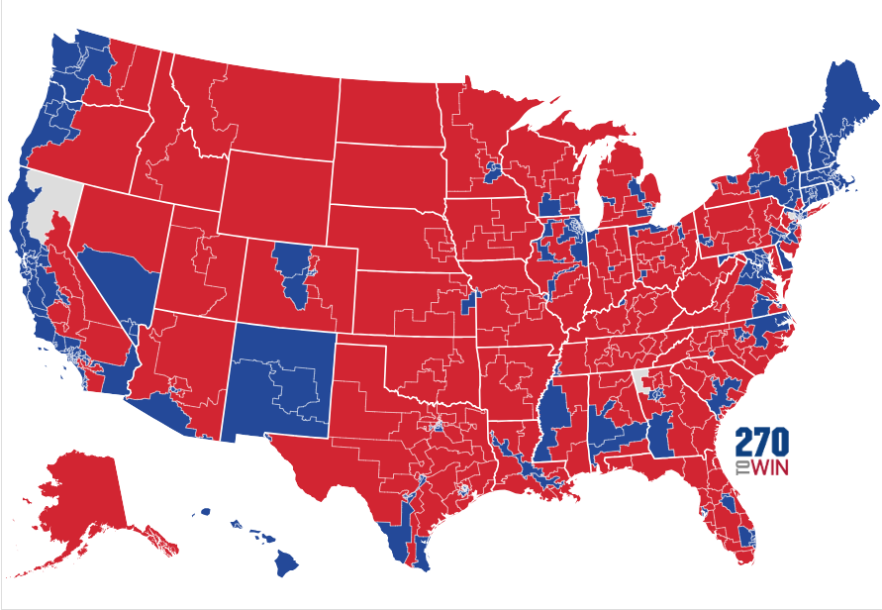
REPUBLICANS HAVE A NARROW HOUSE MAJORITY
Key Takeaways
2024 House of Representatives Election Map
Republicans control the U.S. House with a slight 218-214 majority (3 vacant seats).
Difficult for Speaker Johnson and leadership team to move legislation.
GOP “purity” gives Dem-led coalition the majority (sometimes).
Defied expectations and delivered OBBBA/reconciliation in 2025 and all 12 appropriations bills for FY2026.
President Trump plays an outsized role in moving party policies.
Democrats 214
Republicans 218
Notes:
*Rep. Mikie Sherrill (D-NJ) resigned 11/20/2025.
*Rep. Marjorie Taylor-Green (R-GA) resigned 01/05/2026.
*Rep. Doug LaMalfa (R-CA) died 01/06/2026.

Slide 4
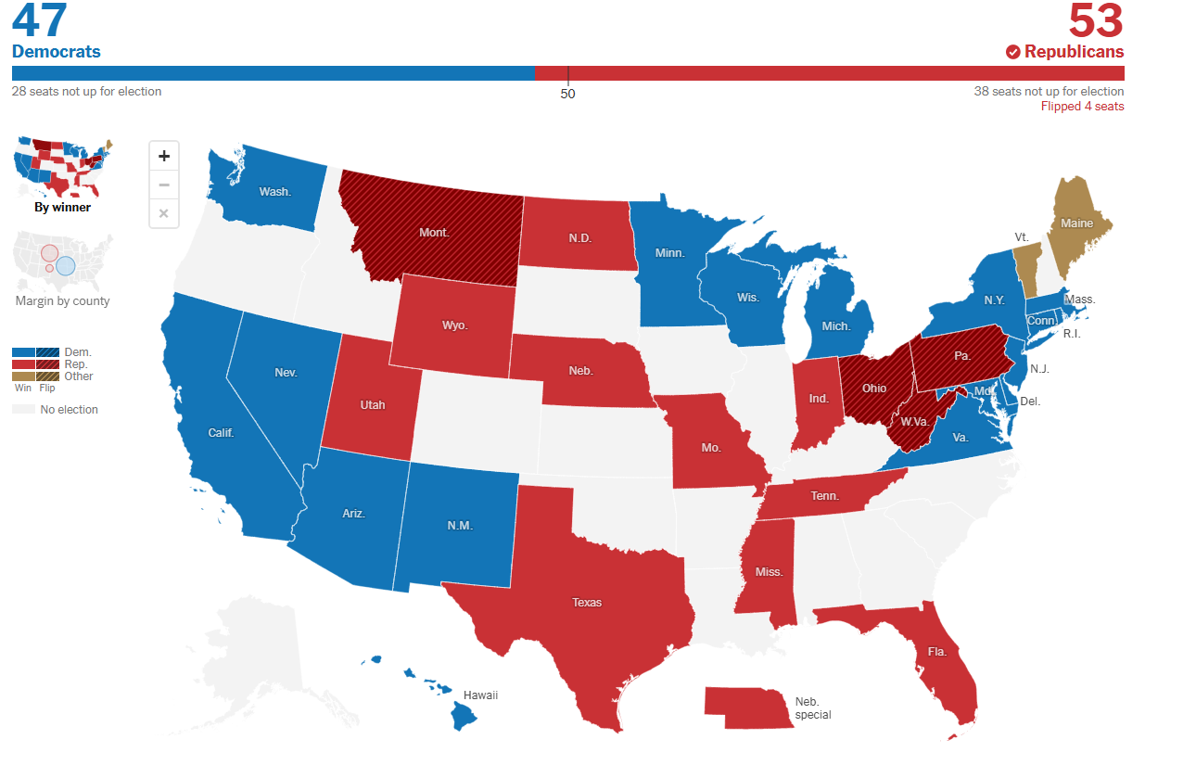
53 SEAT REPUBLICAN U.S. SENATE MAJORITY
Key Takeaways
2024 Senate Election Map
2024 Election
Net pick up of four seats in Montana, Ohio, Pennsylvania, and West Virginia to solidify 53 GOP seats.
New Majority Leader
Sen. John Thune (R-SD) takes over for Sen Mitch McConnell.
Filibuster, Floor Time, and Confirmations
60 Senate votes are needed to pass most legislation (except for budget reconciliation and now lower-level political appointees).
Senate floor time is valuable and minority opposition knows how to bleed the clock.
Confirmations key in first year.
Notes:
Republicans won control of the U.S. Senate by flipping an open independent-held seat in West Virginia; defeating Democratic incumbents in Montana, Ohio, and Pennsylvania; and retaining all the seats they had previously held. Democrats flipped a seat in Arizona from an Independent (Kristen Synema) who caucused with the Democrats.
Democratic candidates were elected in Arizona, Michigan, Nevada, and Wisconsin, despite Trump having won those states. No Republican won in a state that Kamala Harris carried in the presidential election.
McConnell served from 2007 to 2025 as the leader of the Senate Republican Conference, including two stints as minority leader (2007 to 2015 and 2021 to 2025), and was majority leader from 2015 to 2021, making him the longest-serving Senate party leader in U.S. history. He and his teams were masters of Senate procedure.

Slide 5
KEY IEC POLICY ISSUES
American Energy, Manufacturing, and AI Dominance
Permitting Reform
Renewable Energy and EV Charges
Apprenticeship and Workforce Development
Energy, utility, manufacturing, and data center construction opportunities.
Is the window closing on bipartisan permitting reform?
OBBBA sunset many Inflation Reduction Act clean energy construction tax credits, EV charging station construction stalls.
Trump shoots for 1 million apprentices. Expansion of Workforce Pell and 529 educational spending accounts in OBBBA. Flat Congressional spend in FY26 appropriations with 350k labor shortage.
Regulatory Reform
Tariffs and Supply Chain
Immigration
Labor Policy
America first and employer-friendly deregulatory agenda.
Expect more uncertainty on tariffs.
Merit-based system needed.
The good, the bad, and the ugly.
Notes:
House passage of ABC-supported Standardizing Permitting and Expediting Economic Development Act (SPEED) Act (H.R. 4776), introduced by Rep. Bruce Westerman (R-Ark) via the House Natural Resources committee. NEPA reform bill.
House passage of the ABC-supported Promoting Efficient Review for Modern Infrastructure Today (PERMIT) Act (H.R. 3898) via Rep. Mike Collins (R-GA) via the House Transportation and Infrastructure Committee. Clean Water Act Reform Bill.
Congress taking up Clean Air Act Permit Reform bills too.
WOTUS reforms by EPA and USACE

Slide 6
LABOR POLICY: GOOD, BAD, AND UGLY
Commentary
National Labor Relations Board: Quorum means functional NLRB. One more GOP nominee needed to reverse radical Biden-NLRB policies.
Department of Labor:
Teamsters Choice: Secretary Lori Chavez-DeRemer.
Biden Davis-Bacon rule litigation continues.
Forthcoming Independent Contractor and OSHA Heat rule.
Joint-employer rule and Congress.
Union-priority PRO Act (H.R. 20/S. 852): Dead for now, but some Republicans continue to support it (Rep. Fitzpatrick), or aspects of it (Sen. Hawley). The PRO Act’s foil is the Employee Rights Act (H.R. 4154/S. 2984).
Government-mandated Project Labor Agreement (PLA) Policy Continues: Will ongoing litigation stop Trump administration’s extension of Biden’s costly policy?
Notes:
PRO Act: ABC opposes the PRO Act (H.R. 20/S. 852), which includes dozens of provisions that would significantly alter longstanding labor law, override state right-to-work laws, and reduce worker choice when deciding whether to join a labor union.
Sen. Hawley’s Labor Framework: APCA opposes Sen. Hawley’s Labor Framework, which includes the Faster Labor Contracts Act (H.R. 5408/S. 844) and PRO Act provisions that encourage ambush elections and limit First Amendment rights of employers to communicate with employees during union organizing campaigns and elections.
Ask: Cosponsor the Employee Rights Act (H.R. 4154/S. 2984). Key workforce protection provisions of the ERA would guarantee that all union elections occur under secret ballot, clarify the joint-employer standard to protect the flexibility of independent contractors, require worker permission for dues to be used for political purposes, and protect employee personal information and privacy during union organizing campaigns.

Slide 7
2026 OUTLOOK: VERY COMPETITIVE U.S. HOUSE
Key Takeaways
2024 House of Representatives Election Map
2026 Election Outlook
Will state gerrymandering efforts favor one party over the other?
Watch candidate filing deadlines.
Primary dates (early March dates: AR, NC, TX, MS, IL, then 25 states in May and June).
189 solid Dem. and 186 solid GOP seats.
Just 18 tossup and 18 lean (14 D, 4 GOP) will determine majority after 2026 elections.
Democrats 213
Republicans 218
Notes:
State Redistricting:
As of January 2026:
Five states—California, Missouri, North Carolina, Ohio, and Texas—had passed a new congressional map between the 2024 and 2026 elections, and litigation had led to a new map in Utah.
Three states—Georgia, Louisiana, and New York—had congressional or state legislative maps that were subject to change due to ongoing litigation.
Three states—Florida, Maryland, and Virginia—had taken official action toward voluntary redistricting.
https://www.ncsl.org/elections-and-campaigns/2026-state-primary-election-dates

Slide 8
2026 U.S. HOUSE ELECTIONS
LIKELY DEM 8 Dem | 0 Rep | 0 Ind | LEAN DEM 13 Dem | 1Rep | 0 Ind | DEM TOSSUP 4 Dem | 0 Rep | 0 Ind | GOP TOSSUP 0 Dem |14 Rep | 0 Ind | LEAN GOP 1 Dem | 3 Rep | 0 Ind | LIKELY GOP 2 Dem | 14 Rep | 0 Ind
CA-21 Costa IN-01 Mrvan MN-02 OPEN (Craig) MN-01 OPEN (Pappas) NH-02 Goodlander NV-01 Titus NV-04 Horsford OR-05 Bynum | CA-13 Gray CA-45 Tran FL-23 Moskowitz MI-08 McDonald Rivet NE-02 OPEN (Bacon) NJ-09 Pou NM-02 Vasquez NV-03 Lee NY-03 Suozzi NY-04 Gillen NY-19 Riley OH-13 Sykes TX-28 Cuellar VA-07 Vindman | OH-01 Landsman OH-09 Kaptur TX-34 Gonzalez WA-03 Perez | AZ-OPEN (Schweikert) AZ-06 Ciscomani CA-22 Valadao CA-48 Issa CO-08 Evans IA-01 Miller-Meeks IA-03 Nunn MI-07 Barrett NJ-07 Kean Jr. NY-17 Lawler PA-07 Mackenzie PA-10 Perry VA-02 Kiggans WI-03 Van Orden | MI-10 OPEN (James) NC-01 Davis PA-08 Bresnahan VA-01 Wittman | AK-AL Beegich III AZ-02 Crane CO-03 Hurd CO-05 Crank FL-07 Mills FL-13 Luna IA-02 OPEN (Hinson) ME-02 OPEN (Golden) MI-04 Huizenga MT-01 Zinke NC-11 Edwards PA-01 Fitzpatrick TN-05 Ogles TX-15 De La Cruz TX-35 OPEN (Casar) WI-01 Steil
218
189
8
14
18
4
16
186
Solid: races are not considered competitive and are not likely to become closely contested
Likely: races are not considered competitive but have the potential to become engaged
Lean: races are considered competitive but one party has an advantage
Toss up: races are the most competitive, either party has a good chance of winning
*Italicized names denote Freshman members
Source: Cook Political Report, 1/23/26

Slide 9
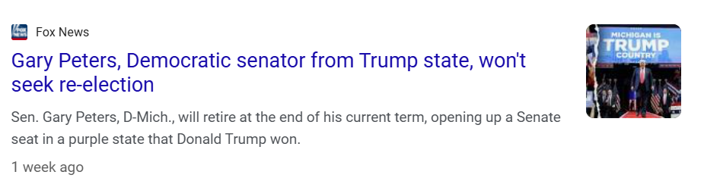
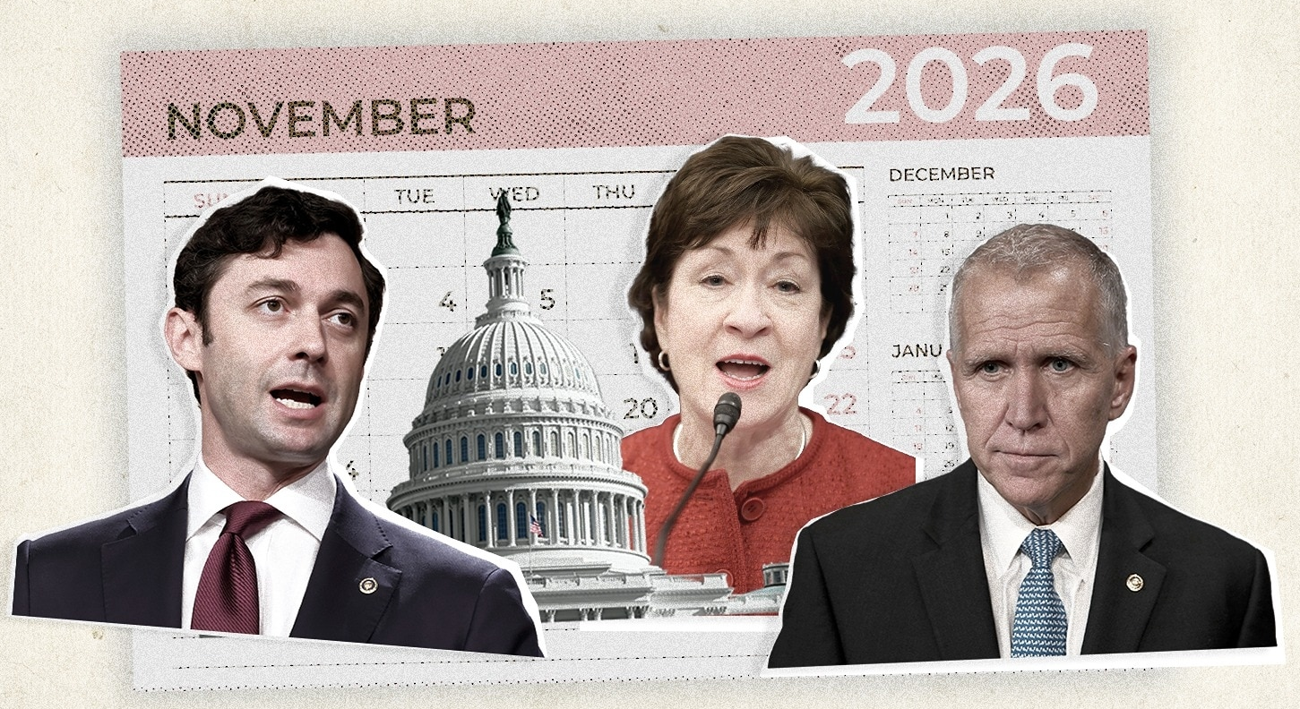
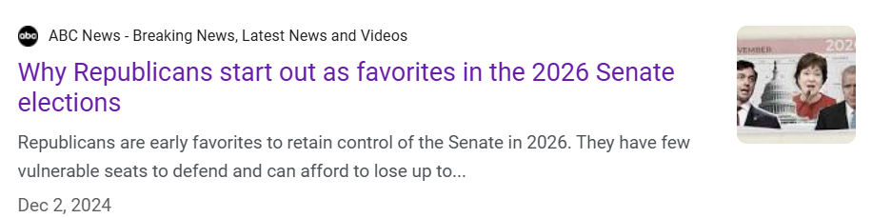
2026 OPPORTUNITIES: U.S. SENATE
Commentary
35 seats up, including special elections in Florida (Rubio) and Ohio (Vance), of which 22 are held by Republicans.
Democrats need to net four seats to flip the Senate.
Republicans are defending just one seat in a state Kamala Harris carried in November (Susan Collins in Maine).
Georgia’s Jon Ossoff (D) and Michigan’s seat vacated by Gary Peters (D) are up for re-election in states Donald Trump won.
North Carolina’s race vacated by Sen. Thom Tillis (R) will be one to watch closely.
Will MAGA and GOP voters engage without Trump on the ticket?
Notes:
There are 35 seats up in 2026 - including special elections in Florida and Ohio - of which 22 are held by Republicans. Democrats can retake control with a net gain of four seats.
https://www.270towin.com/2026-senate-election/

Slide 10
2026 U.S. SENATE ELECTIONS
SOLID DEM | LIKELY DEM | LEAN DEM | TOSSUP | LEAN GOP | LIKELY GOP | SOLID GOP
CO-Hickenlooper DE-Coons IL-OPEN MA-Markey NJ-Booker NM-Luján OR-Merkley RI-Reed VA-Warner | MN-OPEN | NH-OPEN | ME-Collins (R) NC-OPEN (R) GA-Ossoff (D) MI-OPEN (D) | AK-Sillivan OH-Husted | IA-OPEN TX-Cornyn | AL-OPEN AR-Cotton FL-Moody ID-Risch KS-Marshall KY-OPEN LA-Cassidy MS-Hyde-Smith MT-Daines NE-Ricketts OK-Mullin SC-Graham SD-Rounds TN-Hagerty WV-Capito WY-OPEN
There are currently 53 GOP, 45 Dem, and 2 Ind. Senators.
The 2 Ind. Senators caucus with the Democrats.
50
34 no 2026 election
9
1
1
4
2
2
16
no 2026 election 31
Solid: races are not considered competitive and are not likely to become closely contested
Likely: races are not considered competitive but have the potential to become engaged
Lean: races are considered competitive but one party has an advantage
Toss up: races are the most competitive, either party has a good chance of winning
*Italicized names denote Freshman members
Source: Cook Political Report, 1/23/26
Notes:
Includes seats not up for re-election. Control of Senate marked at 50 seats. Current composition is 53-47.
There are 35 seats up in 2026 - including special elections in Florida and Ohio - of which 22 are held by Republicans. Democrats can retake control with a net gain of four seats.
New Hampshire open Senate race after Sen. Jeanne Shaheen declined to seek a fourth term. Kamala Harris carried this state but GOP has a state trifecta. Chris Pappas. Scott Brown (Senator from Massachusetts, 2010-2013) and nominee for this seat in 2014, or John E. Sununu (former U.S. Senator from this seat 2003-2009 and brother of NH Gov. Chris Sununu).
Ohio special election for JD Vance seat after Husted served out 2025 after Gov. DeWine appointed him. Former House Speaker from 2001 to 2009 and then Ohio Senator and then Ohio LG from 2011 to 2019.

Slide 11
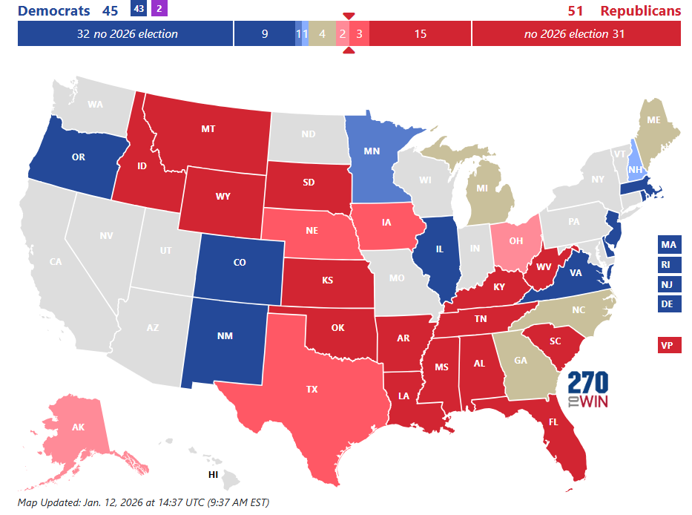
2026 OUTLOOK: U.S. SENATE
Senate Outlook Map
■ Safe Dem. (41*)
■ Likely Dem. (1)
■ Leans Dem. (1)
■ Safe Republican (46*)
■ Likely Republican (3)
■ Leans Republican (2)
■ Toss-up (4)
*Includes 32 Dem and 31 GOP seats where elections are not held this cycle.

Slide 12
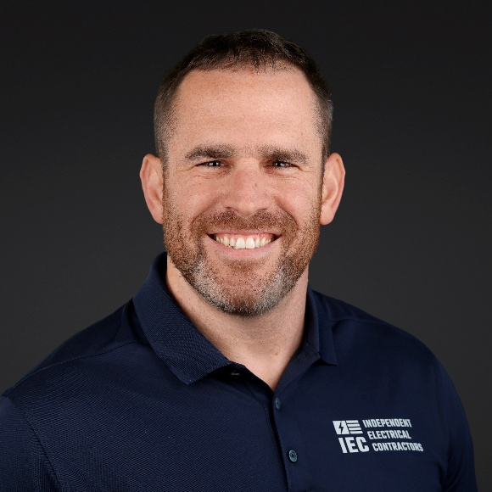
Policy Conference Schedule
Jeremy Croft
IEC Sr. Manager of Government Affairs

Slide 13
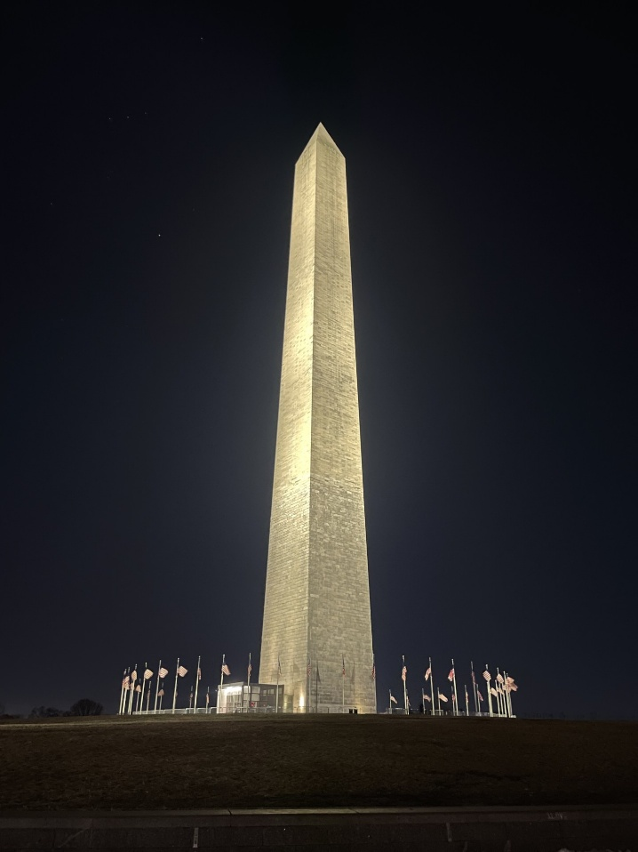
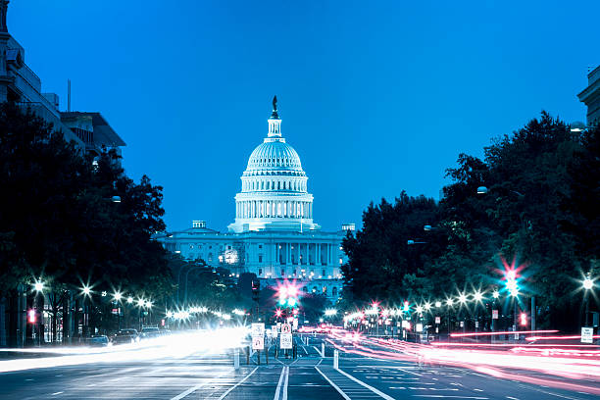
Schedule – Day 1
Time: 5-7 p.m.
Registration and Opening Reception
Night Bus Tour (Optional)

Slide 14

Schedule – Day 2 (Morning)
Time: 7:30 a.m. – 1 p.m.
Registration Open
Welcome & Breakfast
Lawmaker Opening Remarks
How to Lobby & IEC Issues Overview (Ben Brubeck)
Overview of 2026 Elections (NRSC, NRCC invited)
Keynote Speaker Panel Discussion on Labor Issues (Brody Mullins)

Slide 15

Schedule – Day 2 (Afternoon)
Time: 1:15 – 9 p.m.
Panel on Labor and Employment Policy Developments (Kristen Swearingen, Ben Brubeck, House & Senate Committee Staff)
Department of Labor speaker (Henry Mack III invited)
Panel Insights on Data Center Construction & Permitting Reform
Women in Power Happy Hour
PAC Dinner (Officina at the Wharf)

Slide 16
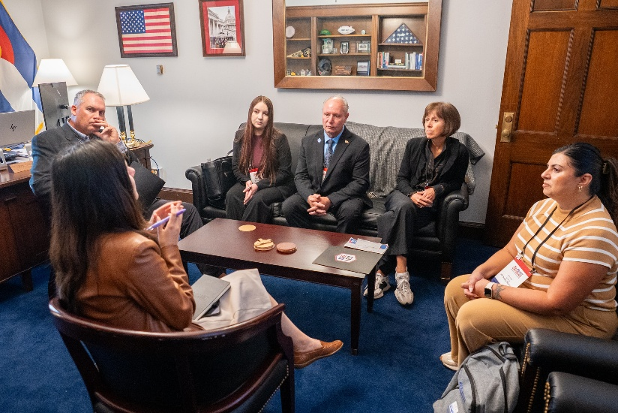
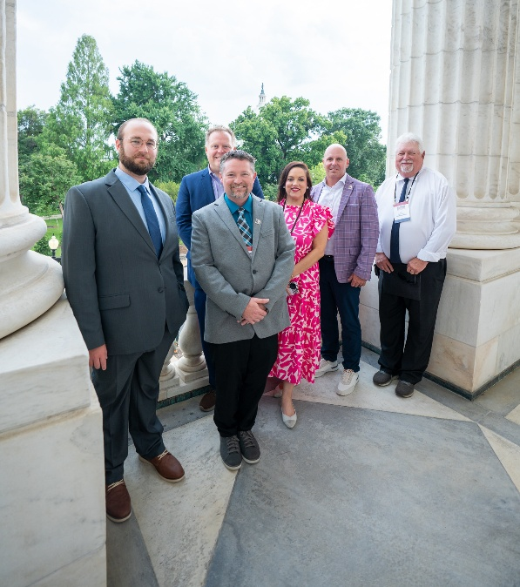
Schedule – Day 3
Time: 8:30 a.m. – 5 p.m.
Leave for Capitol Hill
Capitol Hill Hospitality Suite Opens
Attendee House & Senate Office Visits
Post-Visit Reception

Slide 17
Focus Areas
Permitting Reform
NLRB nominations
Apprenticeships and workforce development
  Grant funding
PLAs
Emerging projects (data centers, EV chargers, clean energy)

Slide 18

Previous Attendee Testimonial
Mahsa Poorak
Southern Electric Company CEO

Slide 19
Know Before You Go
Find out which Congresspeople and Senators represent the districts where you live and work.
Look to see when they may be running for re-election.
Do research on what issues matter to them.

Slide 20
Discuss What Matters to You
IEC Chapters nationwide have some common issues – supporting apprenticeship and merit-shop contractors.
Each region has particular challenges – be ready to talk about them.
Have ideas, if possible, on what best could support your chapter.

Slide 21
Be Yourself
Politicians are just people.
Tell your story!
Try to keep the conversation comfortable and personable.

Slide 22
Questions?

